Slide 1
Who We Are…
People working together
Adults & Youth are welcome to join and volunteer!

Slide 2
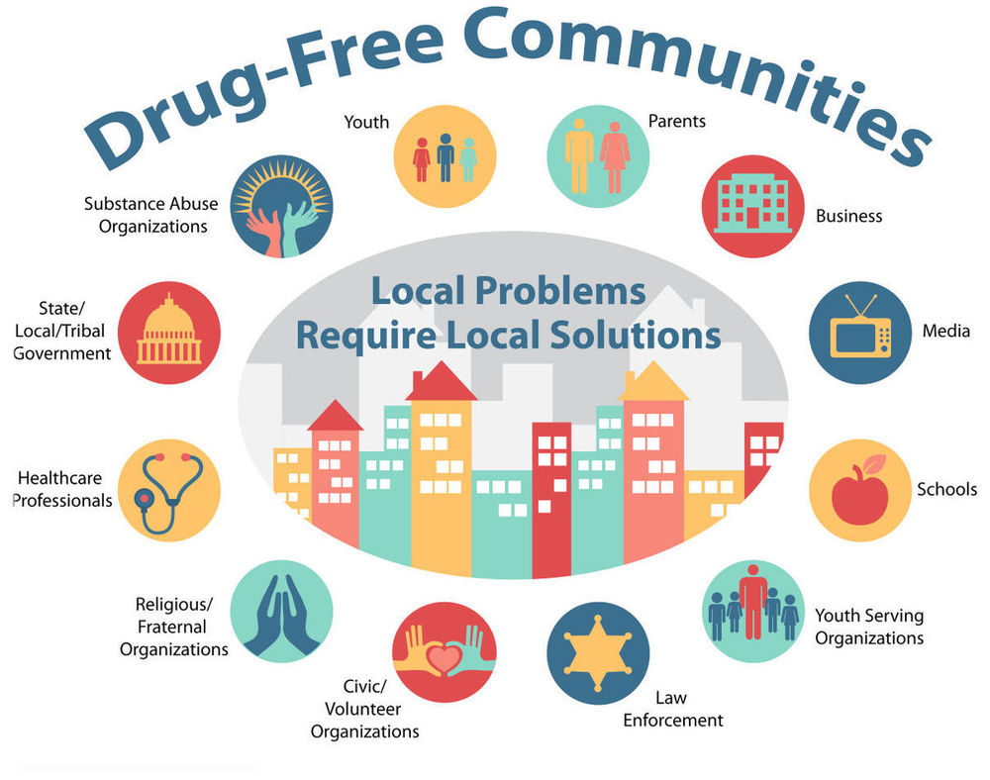
Alone we can do so little.
Together we can do so much.
-Helen Keller

Slide 3
Our Goal
Give the youth in our community
every opportunity to grow-up ​
drug & alcohol free. ​

Slide 4
SACLAz Coalitions
Apache County Youth Council
BeMedSmart
Casa Grande Alliance
Chandler Coalition Against Youth Substance Abuse
Copper Basin Coalition
Fountain Hills Substance Abuse Prevention Coalition
Graham County Substance Abuse Coalition
Greenlee County Substance Abuse Coalition
Help Enrich African American Lives
HOPE Coconino
LPKNC
Marana Prevention Alliance
MATFORCE
Mayahuel Prevention Consortium
Mayahuel Prevention Consortium II – Douglas
Mesa Prevention Alliance
Mohave Substance Abuse Treatment & Education Partnership
Nexus
PAACE Coalition
Peoria Primary Prevention
Pima County Community Prevention Coalition
Rise Up! Glendale
South Mountain W.O.R.K.S. Coalition
Santa Cruz County Drug Free Community Coalition
Southeast Valley Community Alliance
Stand Up AJ
Tempe Coalition to Reduce Underage Drinking and Drug Use
United Prevention: Surprise and El Mirage
Way Out West Coalition
Notes:
We are part of a STATE-WIDE Coalition effort to combat the Current Drug Trends. We collaborate with over 28 Coalitions throughout AZ.
HEROIN + OTHER OPIOIDS IN AZ
http://pact360.org/page/az-opioids
4

Slide 5
Arizona Beating the Odds

Slide 6
Teen Overdose Deaths in AZ
2019
2020
2021
2022
69
87
60
42
Notes:
SAY: Let’s start by looking at the numbers for Arizona. CLICK
SAY: In 2018 CLICK
SAY: 59 teens died of an opioid overdose. CLICK
SAY: In 2019 CLICK
SAY: 69 teens died of an opioid overdose. CLICK
SAY: In 2020 CLICK
SAY: 87 teens died of an opioid overdose. CLICK
SAY: In 2021 CLICK
SAY: 60 teens died of an opioid overdose.
As you see, the peak in this time frame was hit in 2020.
95% of youth overdose deaths in Arizona are from Fentanyl.

Slide 7
Community Impact Strategies
Provide Information
Building Skills
Providing Support
Enhancing Access/Reducing Barriers
Changing Consequences (incentive/disincentive)
Modify/Change Policy
Physical Change

Slide 8
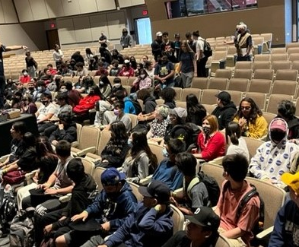
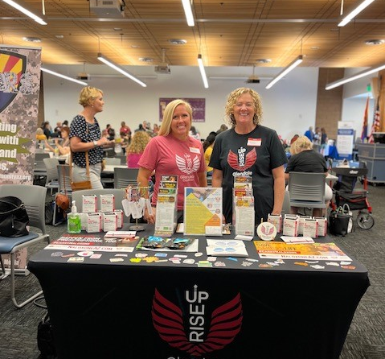
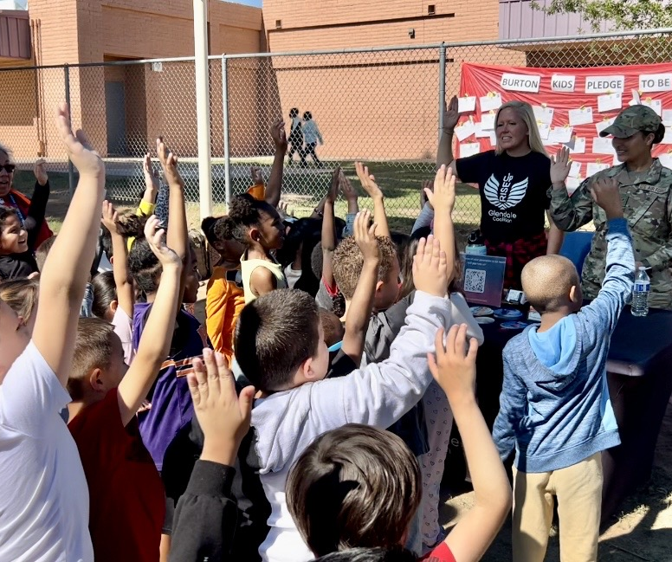
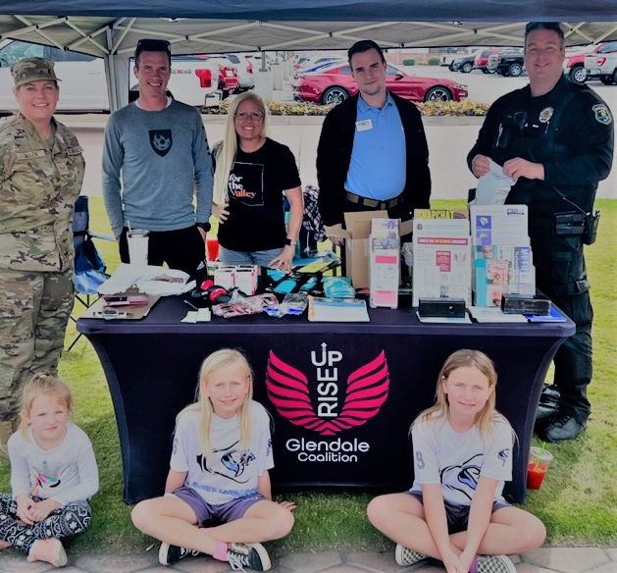
Adult & Youth Education
Classes
Assemblies
Workshops
Town Hall
Citizen’s Academy

Slide 9
CLASSES & WORKSHOPS
FENTANYL, METH, MAIJUANA, NALOXONE, SNAPCHAT, & RESILIENCE
Adult Audience:
Rise of Fentanyl
Meth 2.0
Naloxone
Multi-substance
Snap Chat & Drug Trends
Youth Audience:
A Killer Among Us
Dead on Arrival
Dangers of:
Marijuana
Vape
Alcohol
THRIVE- resilience, substance facts, refusal skills

Slide 10
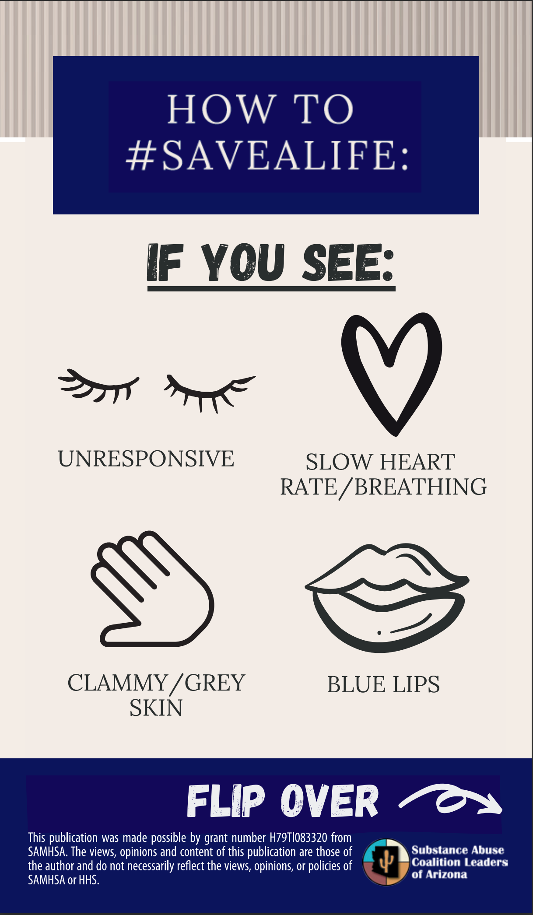
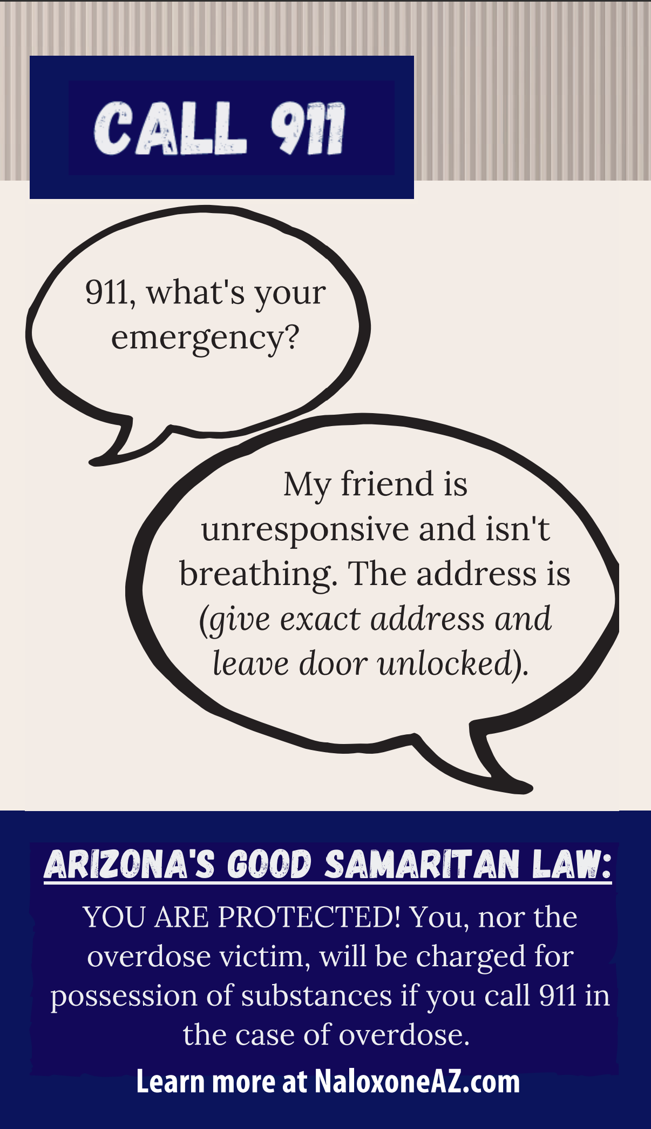
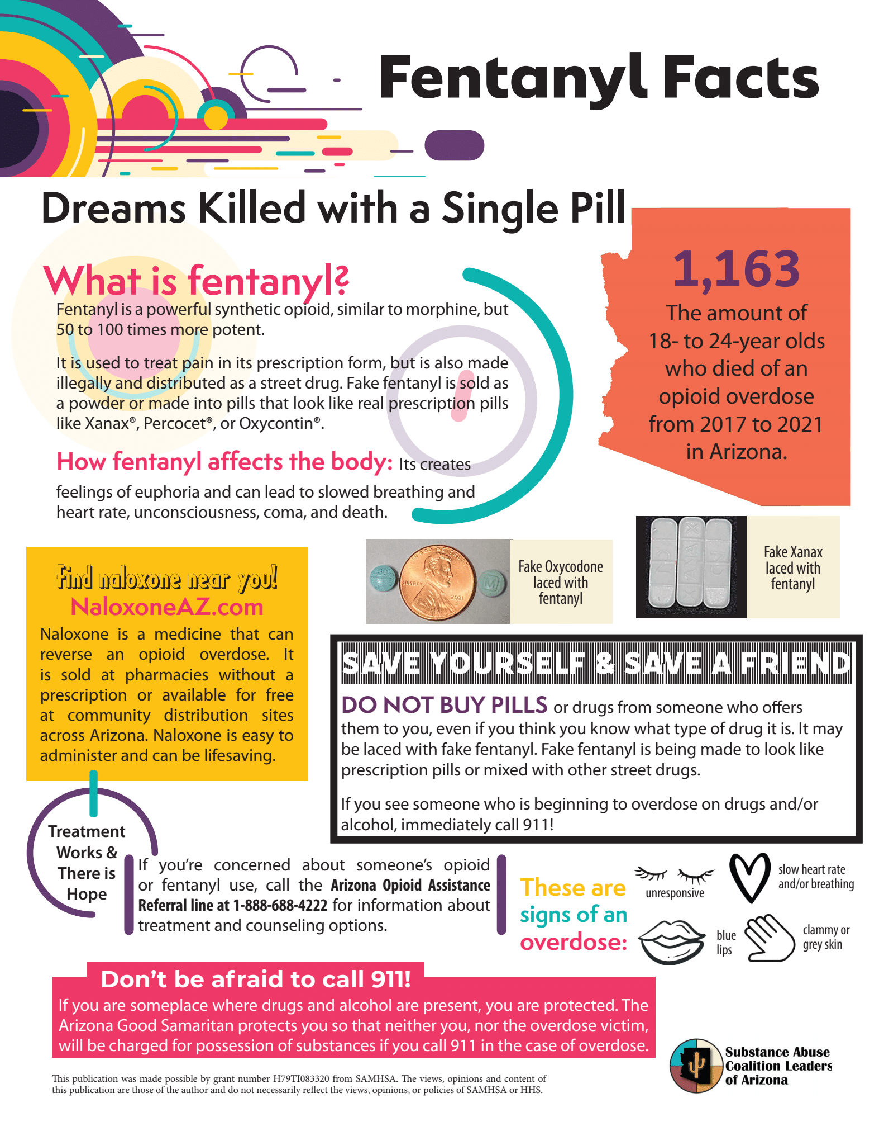

Slide 11
Contact Information

